Slide 1
Programming
Arduino Basics

Slide 2
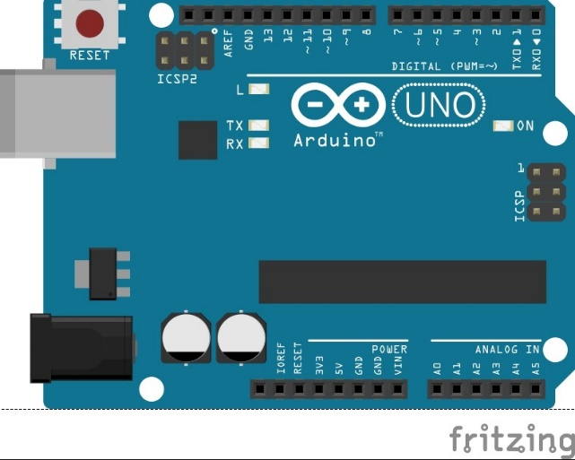
Arduino UNO

Slide 3
Arduino Uno
Power : Vin- 6 to12V DC
5V, 3.3V – Output Supply.
Analog Pins(A0–A5): Used to provide analog input in the range of 0-5V.
Digital pins(D0-D13): Can be used as input or output pins.
PWM (3, 5, 6, 9, 11): Provides 8-bit PWM output.
Frequency (Clock Speed): 16 MHz

Slide 4
Programming Basics
Few important concepts related to general programming before
we move ahead…
Data types – char, int, float, double,etc
Functions
If else ladder
Loops – while, do while, for

Slide 5
Conditional Statements
If else ladder
if(condition){
//statements
}
else if{
//statements
}
else{
//statements
}

Slide 6
Loops
while loop
while(condition){
//statements
}
do while loop
do{
//statements
}while(condition)
for loop
for(initialization; condition; update){
//statements
}

Slide 7
Functions
Functions are set of statements that take inputs, do some specific actions and return an output
Examples
void setup{
//statements
}
int add_five(int a){
a=a+5;
return a;
}

Slide 8
Arduino Code
void setup() – called everytime the module is powered on and called only once
void loop() – this function is called repeatedly till the module has power after the setup function is called
User defined functions can be written as per requirements
Some important functions
pinMode(pin, mode)
digitalWrite(pin,value) & digitalRead(pin)
analogWrite(pin,value) & analogRead(pin)

Slide 9
Motor Driver
The supply provided by the Arduino is not enough for the motors
So we give an external supply to the motors
But because we still want to control the motor via Arduino, we use a Motor Driver between Arduino and the Motors
The Motor Driver takes the signal from the Arduino and drives the motor using the provided External supply to the Driver

Slide 10
L298N Motor Driver
Sophisticated and easy to use
L298N drives the motors but also gives a 5V output voltage which can be used to power the Arduino

Slide 11
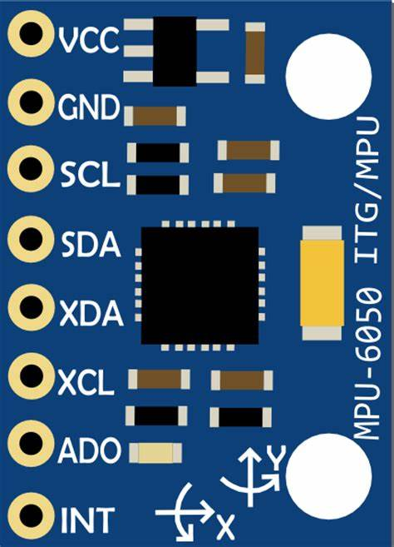
MPU-6050

Slide 12
Description
The MPU6050 module is used for knowing the acceleration & orientation of a system or an object. These values can be used to get other motion related parameters like velocity, displacement, etc
Features
3 Axis Accelerometer & 3 Axis Gyroscope
DMP – Digital Motion Processor
Well documented and many libraries available
Applications
Drones, Self balancing Robots
Used as IMU instrument, tilt sensors

Slide 13
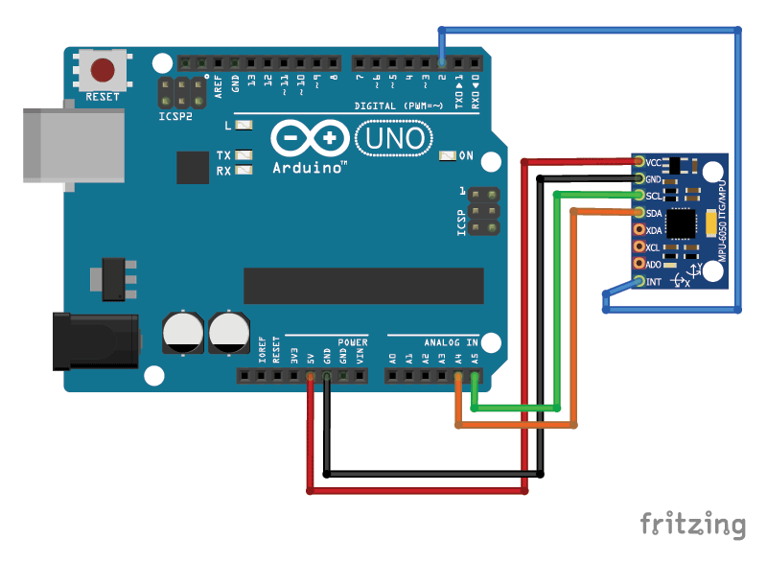
Interfacing with Arduino

Slide 14
Calibration
Why do we need calibration?
Every sensor has an error that prevents it from giving desired values at flat position. This gives us wrong data which may mislead our microcontroller about the orientation.
Calibration
We therefore keep the sensor on a flat surface and make its values to zero/desired values by providing an offset value to each of the 6 Axes the sensor is providing us
If we provide the best possible offset values, then the sensor will report 0 for all accelerations and displacements, except for
Z acceleration, for which it will report 16384 (that is, 2^14).

Slide 15
What is PID?
PID control is a well-established way of driving a system towards a target position or level.
PID (proportional integral derivative) controllers use a control loop feedback mechanism to control process variables and are the most accurate and stable controller.

Slide 16
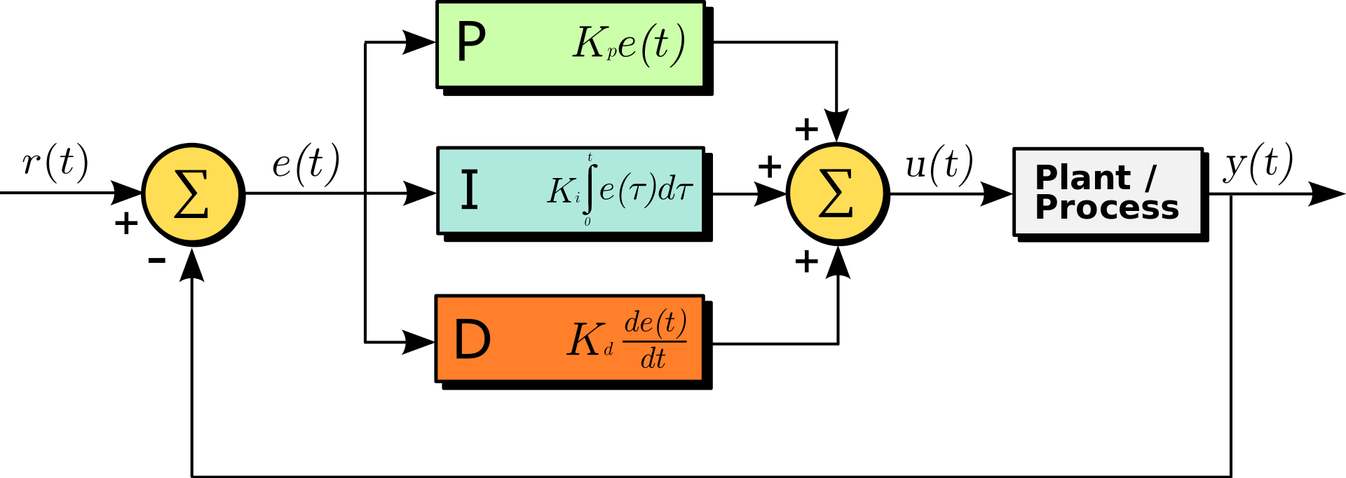
Block Diagram of PID Controller

Slide 17
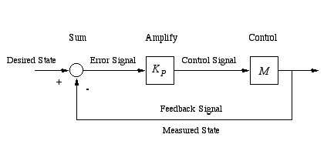
Proptional(P) Controller
In a proportional controller the output (also called the actuating/control signal u(t))
is directly proportional to the error signal(e(t)).
Control signal = Kp X Error Signal
U(t)= kp*e(t)

Slide 18
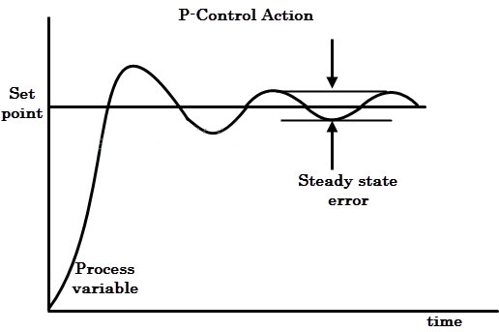
Source:Electronicshub.com

Slide 19
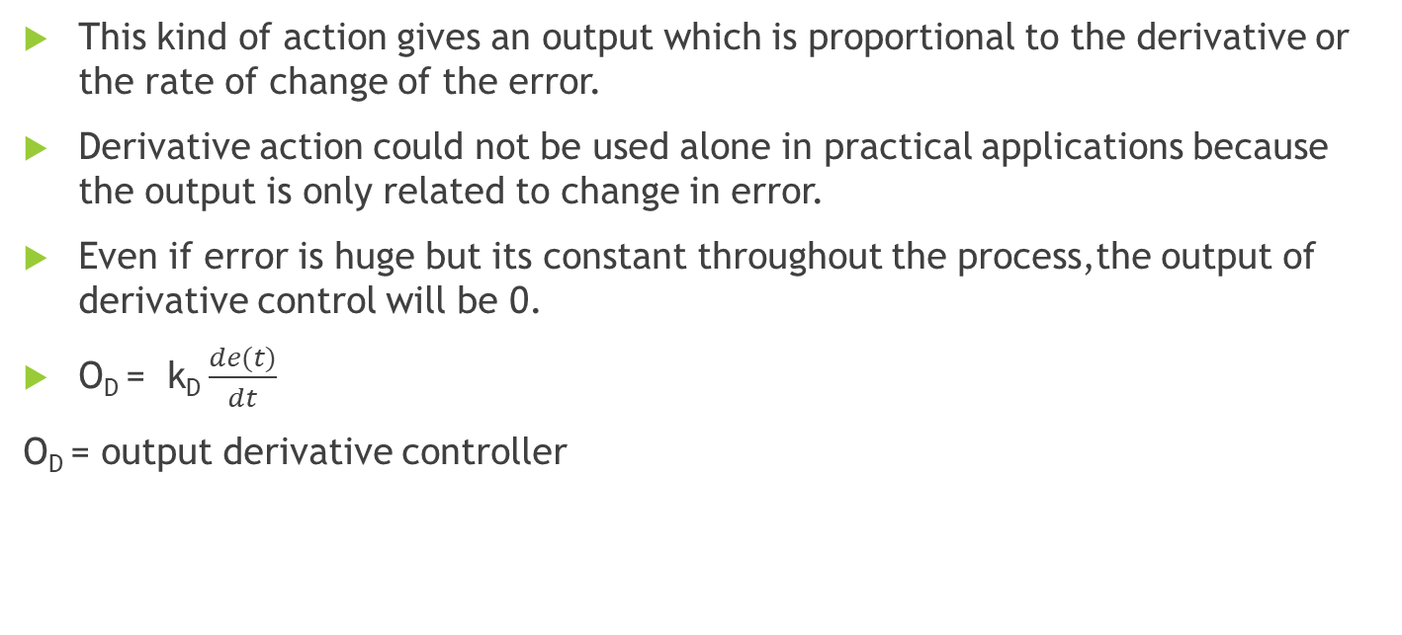
Proportional Derivative (PD) Controller
This kind of action gives an output which is proportional to the derivative or the rate of change of the error.
Derivative action could not be used alone in practical applications because the output is only related to change in error.
Even if error is huge but its constant throughout the process,the output of derivative control will be 0.
O_{D} = k_{D} $\frac{de(t)}{dt}$
O_{D} = output derivative controller

Slide 20
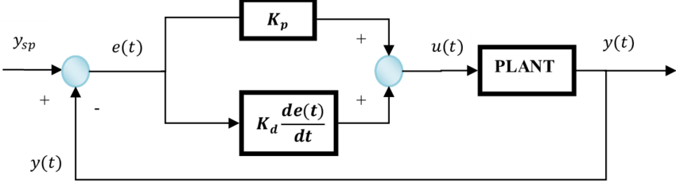
PD Controller

Slide 21
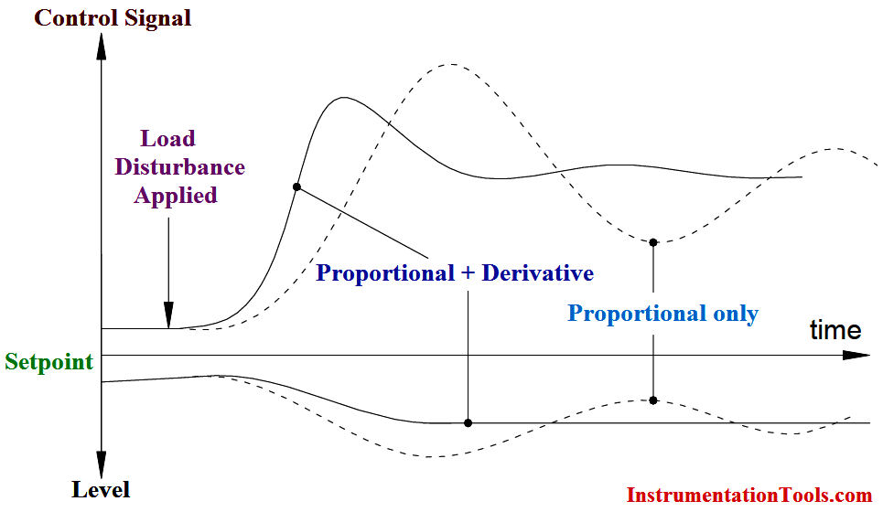
Derivative part in the PD controller reduces the overshoot and improves the transient stability of the control system.
It reduces the time constant of the system and thus making system faster.
It has no effect on the steady state error (derivative part) and on the offset caused by the P controller.

Slide 22
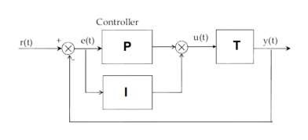

Proportional Integral (PI) Controller
In integral controllers the output is directly proportional to the integral of the error signal.
O_{i} = k_{i} $\int_{0}^{t}{e\left(t\right)dt}$
O_{i} =ouput integral controller

Slide 23
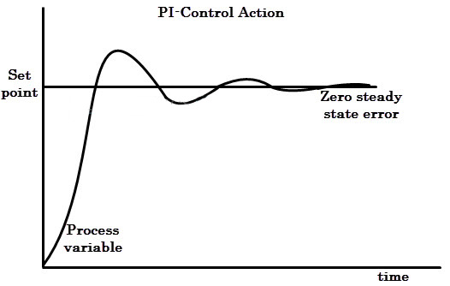
Integral action enables PI controllers to eliminate offset, a major weakness of a P-only controller.
Thus, PI controllers provide a balance of complexity and capability that makes them by far the most widely used algorithm in process control applications.

Slide 24
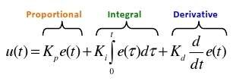
Proportional-Integral-Derivative (PID) Controller
PID controller involves the parallel combination of these 3 controllers and the output equation is proportional to the derivative as well as integral of the error signal.

Slide 25
The Characteristics of P, I, and D controllers
A proportional controller (Kp) will have the effect of reducing the rise time and will reduce, but never eliminate, the steady-state error.
An integral control (Ki) will have the effect of eliminating the steady-state error, but it may make the transient response worse.
A derivative control (Kd) will have the effect of increasing the stability of the system, reducing the overshoot.

Slide 26
HC-05 Bluetooth Module
HC‐05 module is an easy to use Bluetooth SPP (Serial Port Protocol) module,designed for transparent wireless serial connection setup.
The HC-05 Bluetooth Module can be used in a Master or Slave configuration, making it a great solution for wireless communication.
This serial port bluetooth module is fully qualified Bluetooth V2.0+EDR (Enhanced Data Rate) 3Mbps Modulation with complete 2.4GHz radio transceiver and baseband.

Slide 27
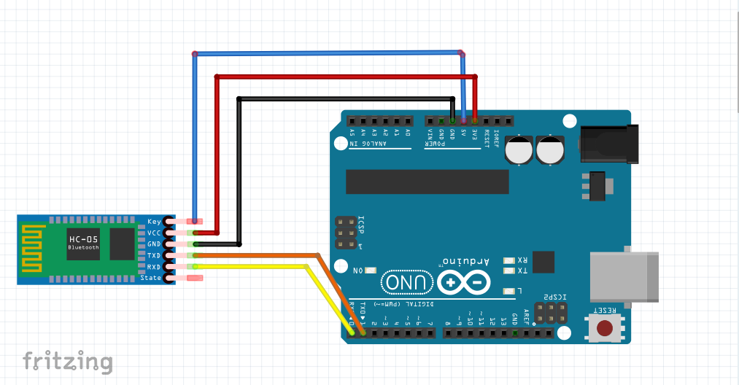
AT Command Mode

Slide 28
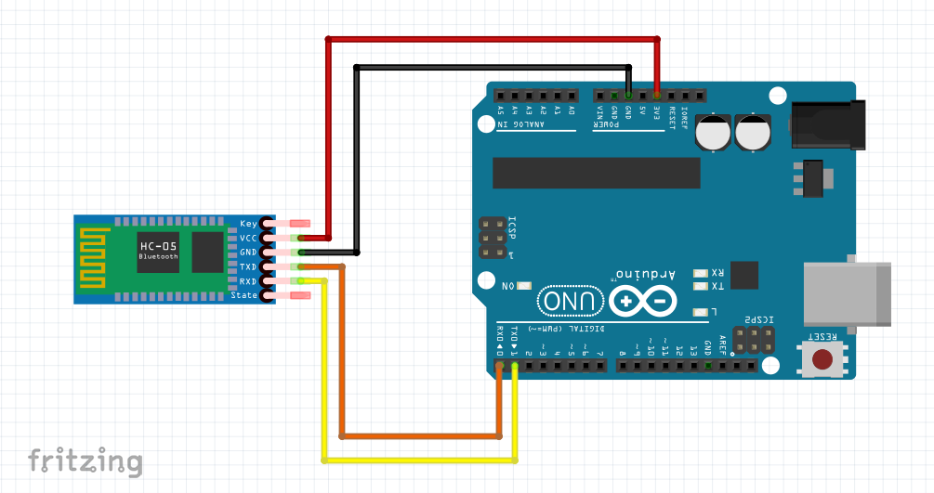
Data Mode

